Slide 1
Emergence of Communication and Information
Jaak Henno,
Tallinn Technical University
“Nothing in this book is true.”
― Kurt Vonnegut, Cat’s Cradle
“ Not everything here might be untrue.”
― JH

Slide 2
Issues:
What is Information ?
What is Language ?
Information and Entropy
Teaching (text-based) Language to computers:
  top-down
  bottom-up
Some results from bottom-up approach – emergence of language in a society of agents

Slide 3
Information
The information content of any message could be measured in bits
Distance between Tallinn and Prague is 1226.71 km
But ‘Distance between’ is not ‘the road or trip from Tallinn to Prague’ and ‘information content’ is not the information...

Slide 4
Information Systems
Information has become the most important commodity of our "information age“
Information systems have become for all technologically developed countries essential part of their national security
With rapid globalization, more and more Information Systems (IS) should co-operate

Slide 5
The success and speed of emergence of these new communication systems has created serious doubt in usefulness of clean formal top-down methods in developing co-operating IS.
The idea of interoperability by means of static fixed formats of communication is giving way to view that communication formats should allow constant changes as communicating parties use their available resources in creative ways to achieve their communicative goals.
(-; :*) 8-) |-O
Left-handed drunken user with sunglasses is snoring

Slide 6
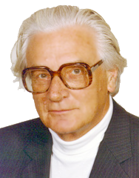
What is Information ?
Tom Stonier: information is a part of the physical universe the same way as matter and energy
Konrad Zuse, inventor of digital computer and the first high-level programming language:
  the whole universe is being computed by some automaton, everything is just a computation
  nobody has yet shown any flaws in Zuse's argument

Slide 7
What is Information ?
Norbert Wiener, the originator of cybernetics: "Information is information, not matter nor energy“
Are bits and bytes information?
Has Information natural properties ?
  Is there an information conservation law?

Slide 8
K Haefner : all natural systems are Information Processing Systems (IPS); each IPS can receive, store, process and transmit information; information processing is an essential internal feature of all systems; the whole universe may be viewed as a gigantic IPS
  K. Hefner (Ed.). Evolution of Information Processing Systems. Springer-Verlag 1992

Slide 9
Tom Stonier : information is a part of the physical universe the same way as matter and energy. Degree of organization of a system is a measure of its information.
  T. Stonier. Information and the Internal Structure of the Universe. Springer Verlag 1990
Creationists: similarly to energy and mass conservation laws there is a law of conservation of information - information cannot be created by either natural processes or chance
  Darwinian Evolution could not create the myriads of Biological Information - Darwinian selection often significantly outperforms blind search , so it has to use some outside information supplied by some Creator

Slide 10
Properties of Information
Instead of conservation information has quite an opposite character: it grows – like a fire or explosion
If somebody/some organization has more information it can act more effectively and also gathere more information
This in turn allows it to grow and propagate further

Slide 11
Information is not just an abstract concept... It is a concrete property of matter and energy that is quantifiable and measurable
Nature ... attempts to dissipate stored information just as it attempts to increase entropy; the two ideas are exactly the same
      Charles Seife, Decoding the Universe, 2006

Slide 12
Information is ...a phenomena that exists in nature, society, mentality of people, virtual reality and in artificial world of machines and mechanisms created by people; information for a system is a capacity to cause changes in the system
      M. Burgin. Theory of Information. Fundamentality, Diversity and Unification. World Scientific Publishing Co, 2010, p 99

Slide 13
Claude Shannon
Claim: “Information theory was developed by C. Shannon” – not true!
    Shannon never claimed that his theorems are about information – he always speaked only about communication
Shannon: "It is hardly to be expected that a single concept of information would satisfactorily account for the numerous possible applications of this general field”
      C. E. Shannon, Collected Papers. N.J.A Sloane, A. D. Wyner (eds), IEEE press, 1993

Slide 14
Information is always semantic – has meaning/semantics (is grounded) and can/will be used by receiver
  information is like (usefull) input to receiver (receiving program)

Slide 15
Growth
Creationists: There is a Law of Conservation of Information;
raising the probability of success of a search by a factor of q/p (> 1) incurs an information cost of at least log(q/p)

Slide 16
New information is created all the time with increasing speed
Google CEO Eric Schmidt:
  “we create in two days now as much information as we did from the dawn of civilization up until - ca five exabytes”

Slide 17
What is Information?
Are blogs and Facebook pages information or should they be considered as informational pollution and forbidden ?

Slide 18
Cognitive psychologists suggest learning methods SQ3R, SQ4R, PQ4R:
      Survey -- Read chapter outlines, chapter headings, recaps, objectives, etc.
      Question -- Formulate questions you believe will be addressed in reading
      Read -- Read material quickly, carefully, actively; try to answer previously formulated questions
      Recite -- Explain aloud to yourself or another person what you have read; use study guide; answer questions at end of chapter
      Review -- Go back over what you have learned; use study guide; reread recaps, reviews, or end of chapter summaries

Slide 19
SQ3R, SQ4R, PQ4R are remarkably similar to what is done in Facebook and blogs
Purpose is not (as much as) to enlighten others, but the author himself
“Puhumalla ne asiat hoidetaan” - things become clear just when discussing them
  Veikko Huovinen, “Havukka-ahon ajattelija”

Slide 20
Singularity

Slide 21
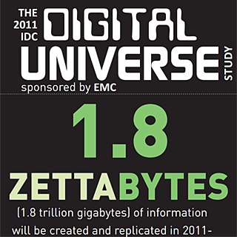
Increase of Information
Amount of man-made information grows exponentially
Currently we create in every two days as much information as we did from the dawn of civilization up until 2003

Slide 22
Internet
The capacity of humans as individuals for advancement of increase of entropy when using only biological memory is limited
Invention of computers and Internet was the new level
Currently the Internet is already a mightier factor than information stored biologically - in our heads

Slide 23
Change of Storage Media
Instead of (language-based, social) memory stored in neurons we are rapidly introducing memory based on Internet computers
For the young generation of digital natives Internet is already a religion - if it is not on Google it does not exist!
Copyism:
  All knowledge belongs equally to everyone
  The search for knowledge is sacred
  The circulation of knowledge is sacred

Slide 24
New communication formats
Digital natives are abondaning glyph-based languages and introducing new communication formats, most often based on video
  to YouTube is uploaded every second more than 24 hours of video
  in Feb 2011 MIT Press released Learning From YouTube - a free online-only "video book“- peer-reviewed with an ISBN number http://chronicle.com/article/Free-Video-Book-From/126427/

Slide 25
Singularity
Internet is not any more only for humans
    more than half of Internet traffic is originated by programs
We are more and more often restricted in our actions in this new environment:
    “You are not allowed to access folder ‘My Documents’ “
Value of information is decreasing
    50 years ago scientific journars payed honorars for contributions – now they ask money for accepting an article

Slide 26
Google
The internet-based memory has become most used memory for digital natives:
  they learn only as-needed – what is needed to solve the current problem
      tomorrow there will be new, different problems
  they do not want to learn just-in-case – there is Google
Is the next step awakening of Google ?
  queries as full sentences allready give better results

Slide 27
But even Google is able to index only less than 10% of Web – and the rate is decreasing
  “My estimate for the size of the Web is in (many) trillions, with Google coverage in a few percent range, and dropping.”

Slide 28
Interactions

Slide 29
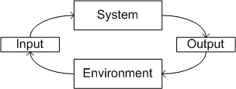
Interactions
We all interact all the time
Inputs from environment :
  perceptions (senses)
Interactions with other agents:
  messages

Slide 30
Interactions with environment
Many formalisms:
  Agents
  Bond systems (bond graphs)
  Cognitive System
  A CS ψ is a function associated to a control structure that belongs to the space of the cognitive control structure C_{s} (ψ ∈ C_{s})
  Learning Classier System (Holland):
    population of binary rules; a genetic algorithm alteres and selects the best rules

Slide 31
Information and Life
Living things interact with their environment in two ways:
  Input1: energy - metabolism, needed for preserving life
  Input2: perceptions (Information!): knowledge about environment; stored in memory and used to get Input1
All outputs are directed to making Input1, Input2 more effective

Slide 32
Entropy
The mathematical expression of Information

Slide 33
Entropy
Entropy is a measure of disorder/order
Order – every part of a system has high probability being in one particular state
High entropy = all parts of a system have (with high probability ) similar/close state
The second law of thermodynamics
  in closed system entropy is increasing

Slide 34
Life – entropy reducer
All living things (plants, animals, humans) reduce entropy – their molecules are in strict order, nearly nothing is random
But they increase the entropy of their
environment more than they are reducing their own

Slide 35
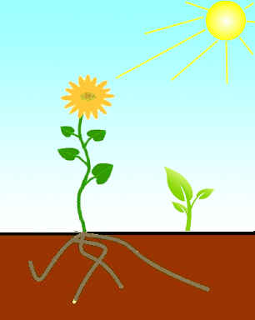
Plants
Plants convert sun rays into cold earth
Plants propagate (seeds, rhizomes)
Plants decrease entropy in themselves, but increase it globally

Slide 36
Animals
Animals convert their food into cold earth
Animals multiply
Animals decrease entropy in themselves, but increase it
  globally more than plants

Slide 37
Humans – best reducer of entropy
Plants reduce entropy strictly locally, inside their organism
They multiply, thus increase entropy
Animals can move and have memory – thus they increase entropy on much larger scale and area

Slide 38
Humans – best information processing devices
The total number of bits processed in every second the human body is
Human head consumes > 25% of all energy used by human
It uses only about 20 watts of power
PC needs a million times as much
Humans invented a tool – language – which makes their memory collective, shared by all mankind

Slide 39
Language
LORD POLONIUS:
What do you read, my lord?
HAMLET:
Words, words, words

Slide 40
Language - how, when and why did it emerge ?
…it is hard not to think that we (humans) are in some way 'special' – a qualitatively different species of any of the … others
…the feature of humanity that…(makes us different) is language
…to understand language, we need to know where it come from, why it works the way it does
Language Evolution: The States of the Art . Oxford University Press. (2003)

Slide 41
Language - how, when and why did it emerge ?
…language evolution is driven by biologically anomalous levels of social cooperation
…phonetic competence … reflects social pressures for vocal imitation, learning, and other forms of social transmission
…human social and cultural strategies gave rise to the complex syntactical structure of speech
The Evolutionary Emergence of Language: Social Function and the Origins of Linguistic Form. Cambridge University Press. (2000)

Slide 42
Language is our proxy of the World
Language is a discrete model of continuous world

Slide 43
Language studies top-down

Slide 44
Language studies top-down
Explain language contructs – ontologies
  Explaining words with other words – circular!
  Closed construct – contain only what designers have added there
Biggest ontology: Cyc
    developed from 1984, currently ver. 1.1
  500,000+ concepts
  5,000,000 assertions (facts and rules), using 26,000+ relations

Slide 45

Cyc, OpenCyc, Shema
Biggest ontology: Cyc
    developed from 1984, currently ver. 1.1
  500,000+ concepts
  5,000,000 assertions (facts and rules), using 26,000+ relations
Schema.org
    Microsoft (Bing), Google, Yahoo!, Yandex
  shared vocabularies webmasters can use to mark up their pages

Slide 46
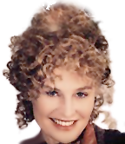
Language study: bottom-up
QUEEN GERTRUDE:
More matter, with less art ...

Slide 47
Handling language bottom-up
Instead of teaching language create algorithms that learn language
  Google
    Understands queries in natural language
  NELL - Never-Ending Language Learning
    a research project at Carnegie-Mellon University to create a system that learns over time to read the web
  Jabberwocky -

Slide 48
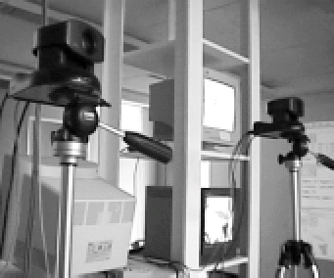
Computer experiments (Steels)
How individual words or groups of words might be associated with meanings by a distributed negotiation process in a population of autonomous agents
  > 4000 agents
  > million language interactions
  agents had limited sensory capabilities:
    Color
    Shape
    Position
The ‘Talking Heads’ experimental setup with two steerable cameras capturing images of geometrical figures in front of them. Each camera is used by an agent in a grounded language game.
Luc Steels, The Emergence of Grammar in Communicating Autonomous Robotic Agents.

Slide 49
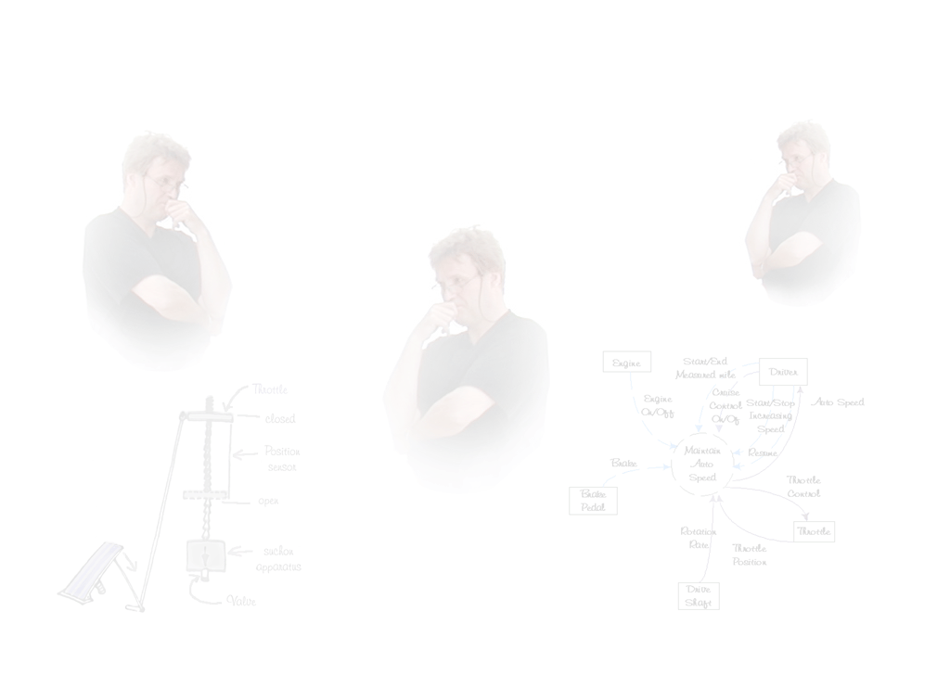
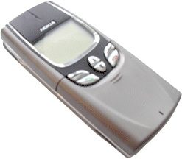
How we perceive world?
Objects
  Have properties (attribuudid)
Object = set of attributes
{blue, rectangular, big,…}
{gray, rectangular, small, nice, buzzing, speaking…}

Slide 50
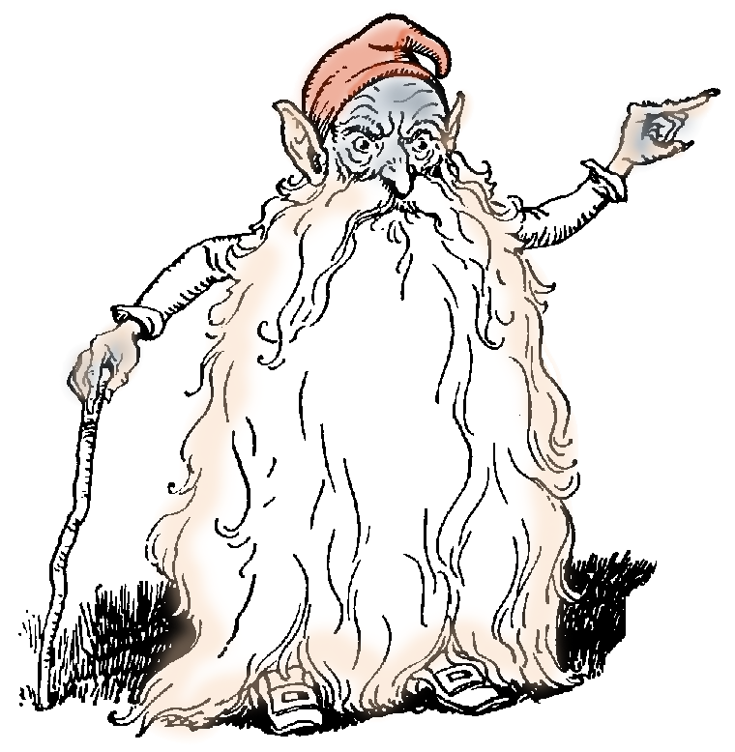
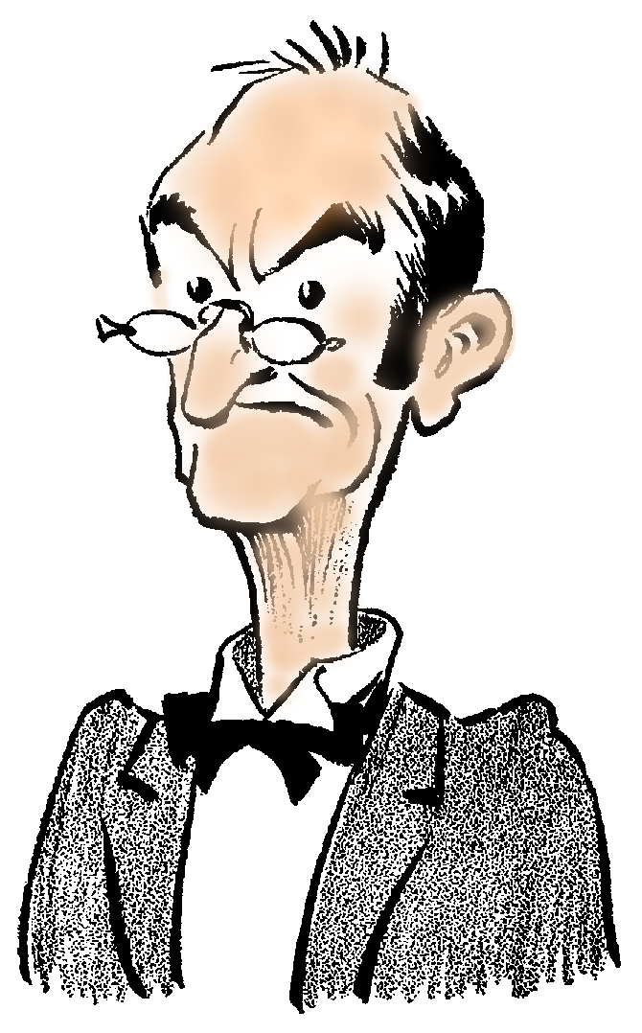
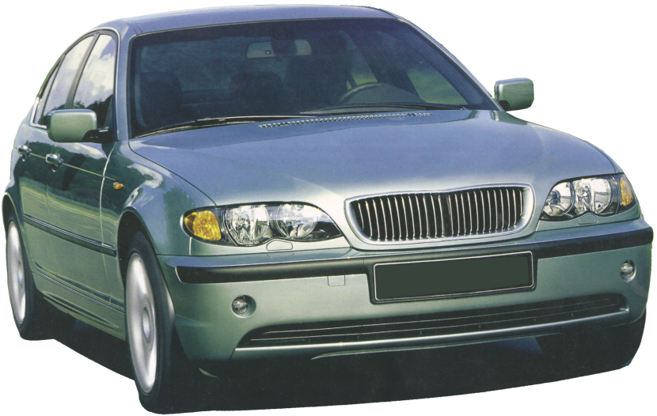
We see things differently
Noizy, smoking,smelling, Lucifer creation, …
240 HP, 6 cylinders, central locking, climate control …

Slide 51
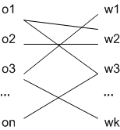
Language
Language is many-to-many mapping between objects and their denotations – words
  Denotations (syntax):
  Semantics (meaning):
Both sets are partially ordered
Galoi’s connection:
D
S
Concepts are fixed points of the function D(S(w))

Slide 52
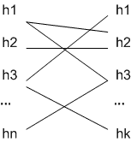
Galoi’s Connection
If the Denotation-Semantics relations are each-others reverse, e.g. D=S⁻¹ = Know (like in Facebook), then the following holds:
Know
Theorem:
The people who know
all the people who know
all the people you know
all the people you know
and
The people you know
all the people who know
all the people who know
All the people you know.
Mathematics Magazine 85 (2012), pp 34-36
Know

Slide 53
Meaning
In all interactions receiver gets something
What ?
The simplest case- arithmetics of natural numbers (definition in Bison):
  exp: NUM { $$ = $1; }
    | exp '+' exp { $$ = $1 + $3; }
    | exp '-' exp { $$ = $1 - $3; }
    | exp '*' exp { $$ = $1 * $3; }
    | exp '/' exp { $$ = $1 / $3; }
    | '-' exp %prec NEG { $$ = -$2; }
    | exp '^' exp { $$ = pow ($1, $3); }
    | '(' exp ')' { $$ = $2; } ;

Slide 54
Semantics - Scott
Scott: $ is a continuous domain of consistent objects with deduction (entailment):
  Information system A=(T,Con,)
    T – tokens, Con ⊆P_{f}(T),  ⊆ (Con\{∅})×T (
    (∀aX  Con) (X  a)
    ((X Y) (Y  a))  (X  a)
    (X  a)  X{a}  Con
    (∀aX )({a}  Con)
    (X Con)(X’ ⊆X)  (X’ Con)

Slide 55
Semantics - Hoare
Every interaction causes some changes, which can be followed with pre- and postconditions:
{P} S {Q} :
C+
  an octopus made by nailing extra legs onto a dog
Has anybody seen a semantic description of OS kernel ?

Slide 56
what is a Proof ?

Slide 57
Truth and Proof
Mathematicians:
  If A then B
  But why A ?
    We need:
    If A’ than A
    …
    If A’’’…’’ then A’’…’’’ … at infinitum

Slide 58

Truth and Proof
Car seller:
  Proof is a nice half-naked lady on bonnet
Women:
  If it looks good/nice then it is true
Car-sellers and women are true
  for their purpose
    Selling a car
    Creating children
Truth is always context-dependent

Slide 59
How to investigate a process?
We (humans) are wery bad at understanding time
    “experience with complex physical systems such as magnets, liquid crystals and superfluids has shown that often these collective properties are surprisingly insensitive to many of the microscopic details and thus the use of extremely simplified models for the constituents is often appropriate to describe the macroscopic properties of the system
The only way to understand a process is the Wolfram’s way: Simulate it (with simple structures)!

Slide 60
Simulations of Emergence of language

Slide 61
Simulation setup
World:
  set of attributes
  set of objects
  set of agents
  Agents have senses and perceive sets of sensations
  On these sets is defined a nearness (proximity) relation (topology)
  The elements of a physical continuum (Poincare 1894) are sets of sensations

Slide 62
Nearness (proximity)
Nearness on the set of sensations X :
    separation:
    Isotony:
Define

Slide 63
Storing and communicating
Agents store their sensations as sets of words
  If they do not have a word for something, they are able to cretate a new distinguishable word
When two agents meet, they perceive the same sensations (they act in the same physical continuum)
  They are eager to share
In this situation (local environment) they communicate

Slide 64
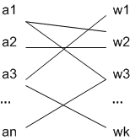
Language of an agent
For every agent ag,
language of the agent
is a many-to-many binary relation
between attributes (perceptions from real word) and words (denotations of perceptions).
At the beginning of simulations all

Slide 65
Information compression: Names
Objects are determined by their attributes and sub-objects
Agents compress perceived set of attributes giving it a name
A name is an virtual attribute
  agents do not perceive it
  they perceive only 'real' attributes
  they use names in communications just like real attributes

Slide 66
Agent’s data Structure
Vocabulary
  lists of attributes with denotations, i.e. words
  list of objects
Language of an agent a:
e.g.

Slide 67

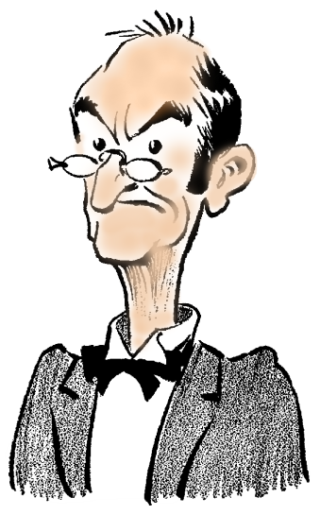
Communication act
Sender (randomly)
Communication object = set of attributes [a₁,a₂,…,a_{n}]
Message: sender selects some attributes [a_{i1},a_{i2},…,a_{in}] and seeks for them proper words (when needed, invents a new word) sends a two-part string:
< [a₁,a₂,…,a_{n}] [w_{i1},w_{i2},…,w_{im}]>
Receiver gets the string <[a₁,a₂,…,a_{n}] [w_{i1},w_{i2},…,w_{im}]>
(indication of object and denotations of some of its attributes) and tryes to guess the meaning of words w_{i1},w_{i2},…,w_{im}, i.e. attributes a_{i1},a_{i2},…,a_{in}

Slide 68
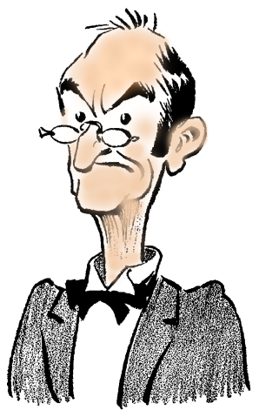
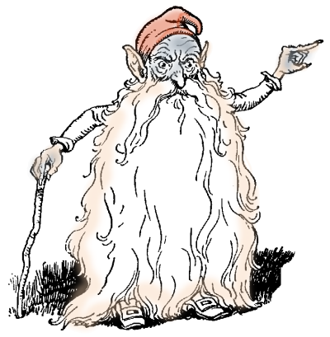
Learning worlds
Two objects: [2, 4], [2, 3]
The first message: [2,4],[a4_1, a2_1, a101_1]
    2 → a2_1; 4 → a4_1; a101_1 – name of the object [2,4]
Language of receiver becomes:
  [2, [[a101_1, 1], [a2_1, 1], [a4_1, 1]]]
  [101, [[a101_1, 1], [a2_1, 1], [a4_1, 1]]]
  [4, [[a101_1, 1], [a2_1, 1], [a4_1, 1]]]
The second message (to the same receiver): [2,3],[a2_1, a102_1]
Language of receiver:
  [102, [[a102_1, 1]]]
  [2, [[a4_1, 1], [a2_1, 2], [a101_1, 1]]]
  [3, [[a102_1, 1]]]
  [101, [[a4_1, 1], [a101_1, 1]]]
  [4, [[a4_1, 1], [a101_1, 1]]]
List of objects:
[O1,2,4]
List of objects:
[O1,2,4]
[O2,2,3]

Slide 69
Local Environments
All interactions of agents with world objects and between agents occur always in some finite local environment
Local environments are defined by geometry and/or time and agents who have the same physical (perception) continuum :
  agent(s), object(s) inside some space structure (corridor in labyrinth)
  agent(s), object(s) inside some time interval (e.g. day)

Slide 70
Communication act
Suppose , perceive
creates a message
Agent receives

Slide 71
Information processing
Receiver , his language
Received message
Processing:
Update:

Slide 72
Maximum entropy modelling
The algorithm of processing should satisfy the Bayesian principle of maximum entropy:
  use only provided information
  do not assume anything
From here it follows, that entropy of agent languages should all the time remain less than the entropy of the World

Slide 73
Entropy of the World
World:
Shannon’s entropy (attribute-based view of the world):

Slide 74
Object-oriented view
For an agent, World consists of objects – groupes of attributes perceived close to each other (the proximacy relation)
Difference of objects:
Entropy of the (object-oriented) world:

Slide 75
Entropy of a language
Entropy of a language as a many-many weighted mapping

Slide 76
Properties
Entropy of an 1-1 mapping with uniforme wages
is
Example.
L=
0.8475391410549273 + 0.0363129626424490 = 0.8838521036973764

Slide 77
Measures of Convergence
Message understanding:
    understanding of full messages
    understanding of names only
Statistics of the pool of languages:
    number of words
    dispersion of frequencies in word list
Entropy - emergence of language is a process of step-wise removal of uncertainty about the model of the world created in language

Slide 78
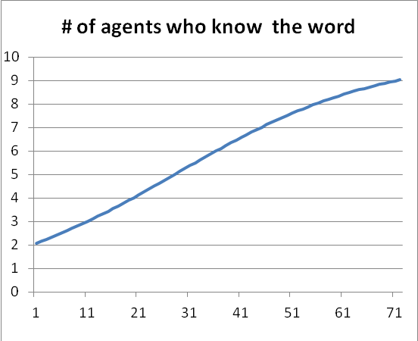
Proliferation of Words
- number of agents, who after t-th conversation have a word for attribute a
- probability of attribute a in a randomly selected conversation object

Slide 79
Example
Obj=[[1,4], [1,6,2], [4,2], [1,3,2,5], [1,4,5], [4,3,6], [1,3], [3,5,2], [6,5,4], [3,4,1], [1,2], [4,5], [3,2], [1,6], [1], [5,3,1], [6,1,5], [6,3,5], [1,5,6,2], [4,5,2,1], [5,6,4,1], [4,2,3,6], [1,3,2], [4,6,2], [6,2,5,3], [5,3,1,6], [4,6], [5,6,3,4], [4,2,6,5], [6,2,5], [1,6,4,3], [6], [1,6,3], [4,3], [3,4,5], [4,1,2,6], [2,6], [3,1,2,6], [5,4,2,3], [5], [3], [3,6], [1,4,3,2], [6,5], [1,5], [2,5], [4], [1,4,2], [4,3,5,1], [2]]
50 objects over 6 attributes
= 5.97
= 5.64

Slide 80
Results of measurements made after every 500 communications; communications + measurements were repeated 10 times; sender, receiver and communication object were selected randomly.

Slide 81
Strategies
The simplest algorithm – word propagation
  receiver only stores the received word in all lists of attributes and names which occur in this local context and adjusts their use count
  tallies best with the principle of entropy maximization
  totally passive method is memory utilization
    apply garbage collection – remove words with small use count

Slide 82
More active strategies
Wiser speaks first:
  older people are honoured and their sayings are considered important – they are more confident in what they say
  confidence can be estimated with the average word count in agent’s language – can be estimated on the fly
  when two agents met, speaker was the agent who had higher confidence index
Reciprocity – you speak to me, I speak to you

Slide 83
Self-learning
Language of receiver:
  [102, [[a102_1, 1]]]
  [2, [[a4_1, 1], [a2_1, 2], [a101_1, 1]]]
  [3, [[a102_1, 1]]]
  [101, [[a4_1, 1], [a101_1, 1]]]
  [4, [[a4_1, 1], [a101_1, 1]]]
New message (without indication of object!): [a3_1, a2_1, a102_1]
  a3_1 → ?
  a2_1 → 2
  a102_1 → 3
  a3_1 is the name for O2 !
Most of the words what we know have we learned them from context !
    Sternberg, RJ (1987). Most vocabulary is learned from context.
    In MG McKeown&ME Curtis (eds.), The nature of vocabulary acquisition 89-106
List of objects:
[O1,2,4]
[O2,2,3]

Slide 84
Results(1)
Number of messages | Number of learned attributes | Number of words for an attribute (average) | Average number of mistakes in 10 test messages
0 | 19.9333 | 9.74 | 4.46
500 | 20 | 12.81 | 3.26
1000 | 20 | 13.81 | 2.80
1500 | 20 | 14.00 | 2.70
2000 | 20 | 14.34 | 2.74
2500 | 20 | 14.56 | 2.51
3000 | 20 | 14.84 | 2.57
3500 | 20 | 14.78 | 2.34
4000 | 20 | 15.07 | 2.42
4500 | 20 | 14.82 | 2.21
5000 | 20 | 14.72 | 2.20
Numbber of learned attributes (which have at least one word), average number of words per attribute, average number of mistakes per 10 test messages (30 agents, 20 attributes, test after every 500 communications).

Slide 85
Results(2)
N | #W | #W
1 | 5 | 9
2 | 2 | 8
3 | 1 | 1
4 | 11 | 13
5 | 2 | 8
6 | 1 | 2
7 | 1 | 1
8 | 2 | 11
9 | 1 | 5
10 | 8 | 12
11 | 2 | 13
12 | 2 | 8
13 | 10 | 4
14 | 1 | 7
15 | 2 | 6
16 | 1 | 13
17 | 5 | 1
18 | 1 | 1
19 | 3 | 9
20 | 9 | 9
Average: | 3.5 | 7.5
How number of different words for an attribute changes; 30 agents, 2000 communication acts; in the second column the probability to use agents "own" word was 0.9, in the third - 0.1; difference in averages is essential.

Slide 86
Results(3)
Atr No | Frequencies of different words for this attribute
1 | 199,1,1,1,1,1
2 | 208,1,1,1,1,1
3 | 217,1,1,1,3,2
4 | 1,223,1
5 | 1,235,1,2,7,1
6 | 1,240
7 | 1,1,5,210,1,4
8 | 5,1,1,1,224
9 | 1,213
10 | 226,1,4,1,0,1,1
11 | 1,216,2,2
12 | 198,2,1,1,1,5,4,1,1,1
Freaquences of different words for an attribute after 10000 communications (10 agents, 12 attribuuti). For an attribute was always selected the most frequent word.

Slide 87
What we say and what we know
The first 10 series contained 100 full messages, the next 10 series were self-learning - 100 pure messages.
After every series percentage of common words (i.e. attributes and names, for which agents used the same word) and percentage of correctly understood messages was measured.
1. Message understanding was much higher/better than the number of common words
2. The percentage of common words grows with pure messages nearly the same way as with full messages
" what children say ...is a quite imperfect measure of what they know"
Bloom, P. Myths of word learning. In: D.G. Hall & S.R. Waxman (Eds.) Weaving a lexicon, Cambridge, MA: MIT Press

Slide 88
Vocabulary spurt
Many specialists in child learning claim, that at about 16 months of age, or when a child has learned about 50 words children word learning sharply accelerates
Percentages of correctly understood messages in series of communication acts with different number O of objects

Slide 89
Conclusions
If agents
  have memory and can perceive their environment
  are able to create different signals
  are eager to share their perceptions
Then very simple data structures for agents and algoritms for creating and processing messages allows agents to create common language, i.e. the process converges

